Slide 1
Wildfires in the United States
Sagnik Rana
Daniel Lesser
March 6, 2019
95-885 Data Science and Big Data

Slide 2
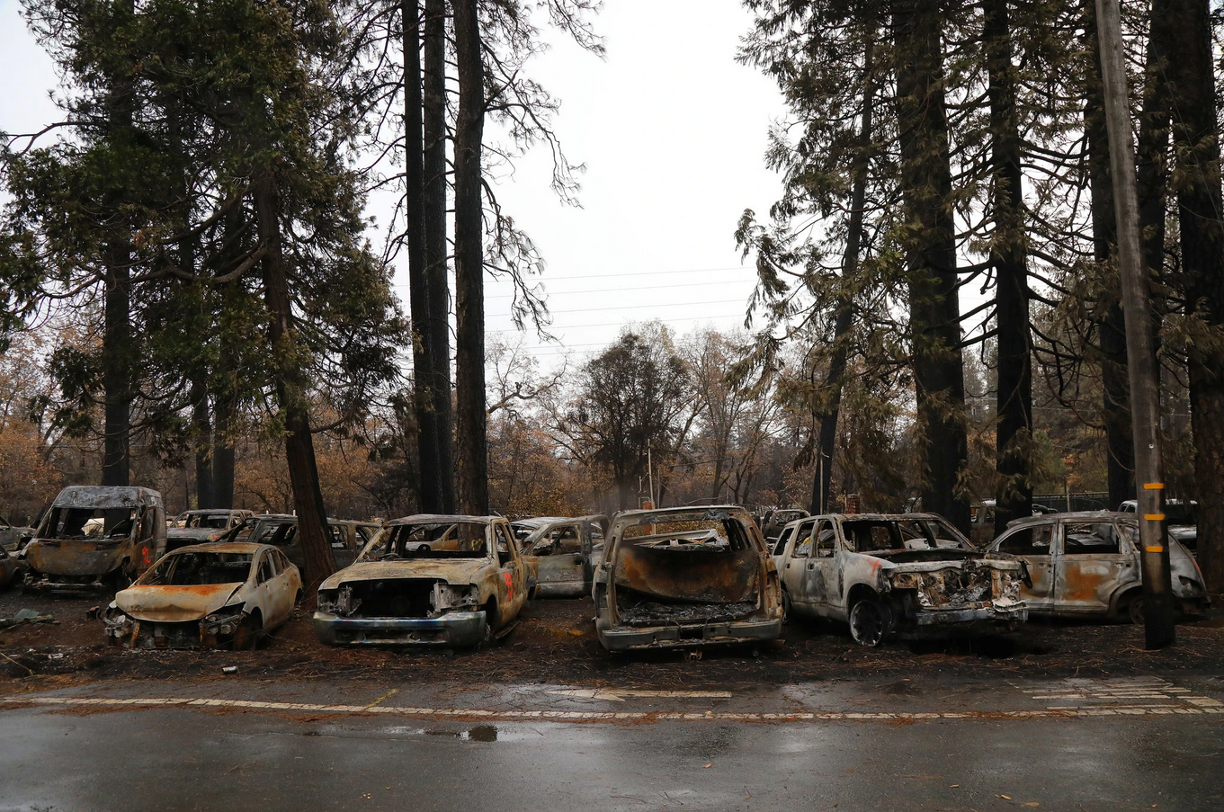
The problem
Wildfire severity and impact on human life appears to be on the rise
Recent high profile fires in California (Camp Fire, Mendocino Complex) have led to increased public awareness
The fires have led to loss of life, reduction of habitat, financial burden and increased political discourse
Notes:
Life: >40 died in mendocino
Habitat: owl
Financial: P&E bankruptcy, homes destroyed

Slide 3
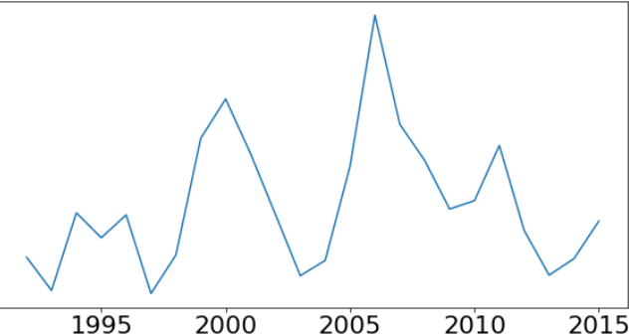
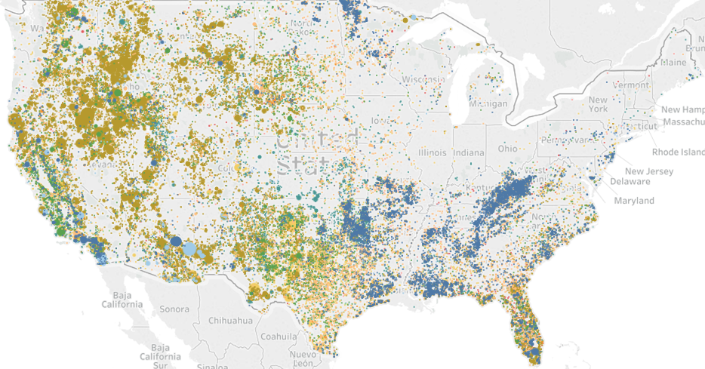
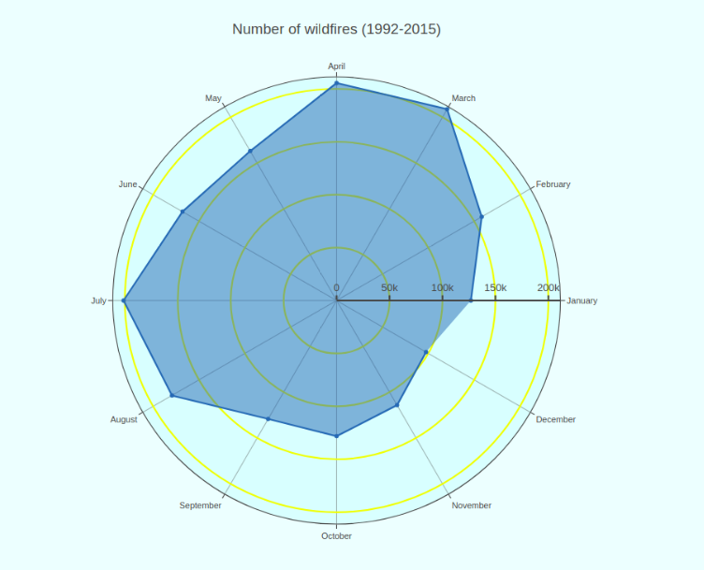
The questions
Has wildfire frequency increased over time?
What states are the biggest contributors to wildfires nationwide?
What are the biggest causes of wildfires? Do these causes differ by state?
What times of the year are wildfires most likely to occur?
Are annual rainfall totals an indicator of wildfire frequency?
Notes:
When measuring wildfire frequency, should consider count vs. total acreage burned.
Are there certain hot spots that have been overlooked? What states have seen the biggest increases? Decreases? Are there lessons to be learned?
What are the causes: smokey the bear told us that only we can prevent forest fires. True?
Are wildfires occurring during a wider time frame each year?

Slide 4
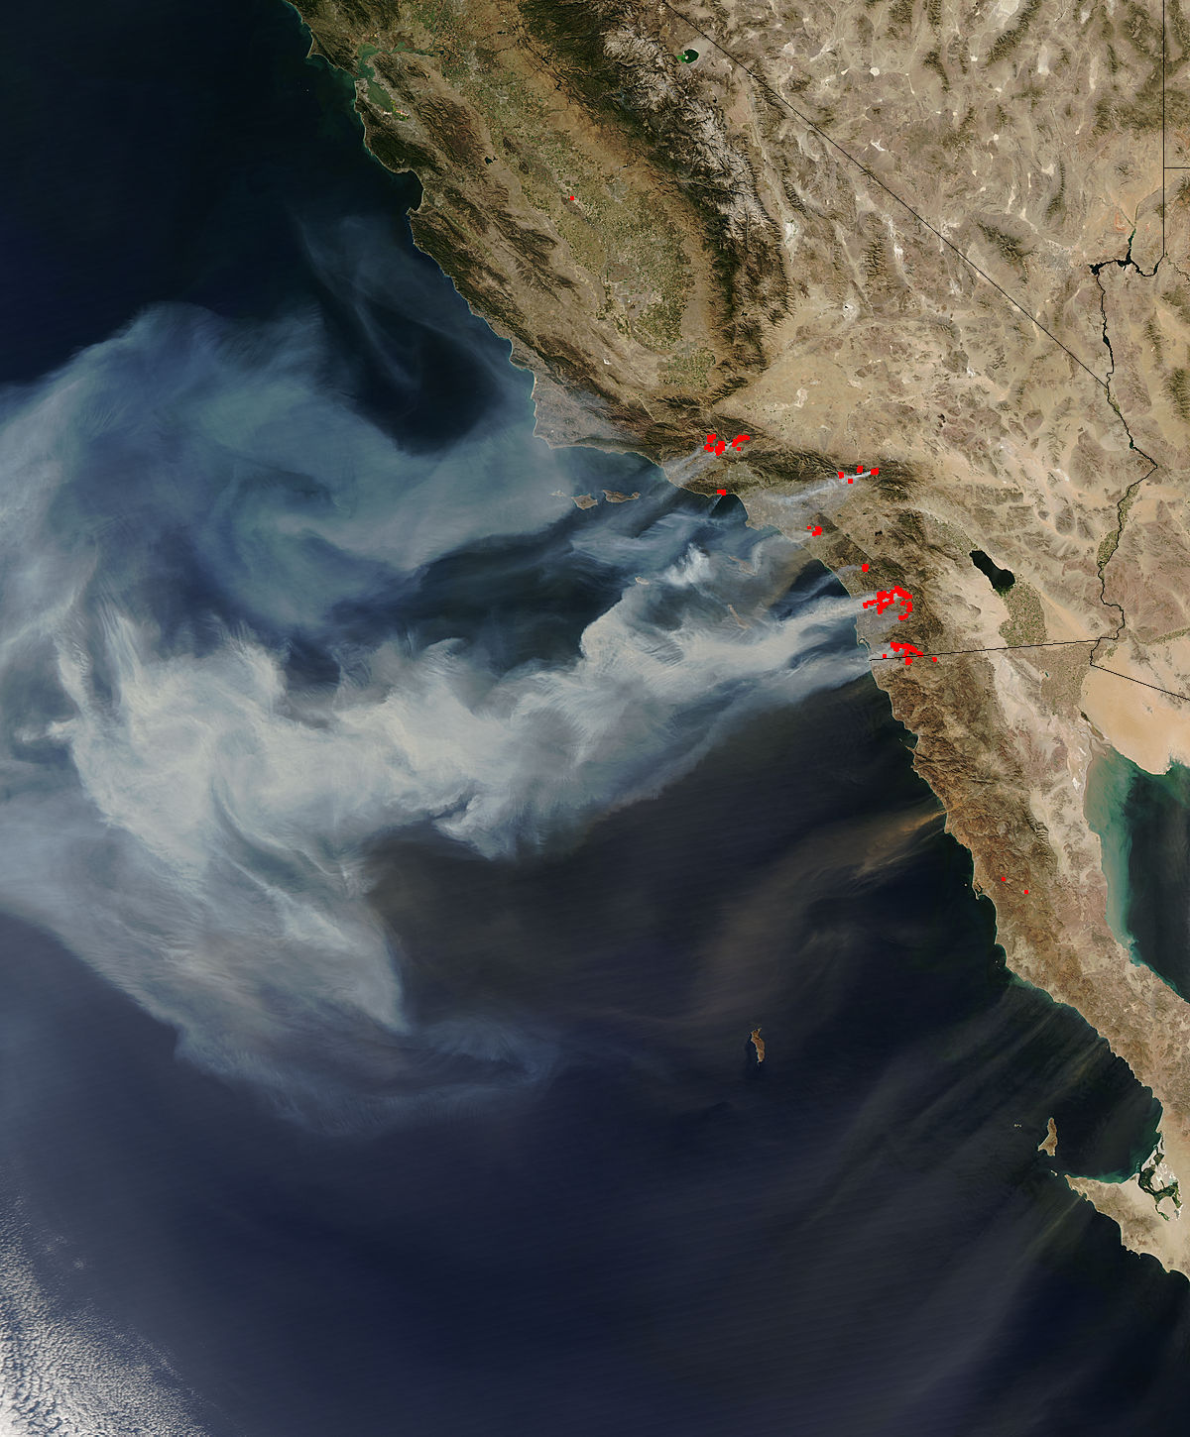
The hypotheses
That wildfire frequency has not only increased over time, but that the rate of increase is accelerating
That California and the west coast are the hardest hit states
That humans and preventable causes are the leading contributors to wildfires
That wildfires are becoming more dispersed throughout the year
That rainfall is a strong indicator of wildfire severity and that climate change may be a factor in the increase of wildfires
Notes:
Additional sources / prior research:
U.S. Forest Service has produced research papers on the impact of Climate Change on Wildfires. https://www.srs.fs.usda.gov/news/545
University of California including several publications. https://ucanr.edu/sites/forestry/Wildfire/

Slide 5




The data
Cooperative Fire Program Analysis conducted by USDA and DOI
Integrated reporting of Wildfire information 1992-2015 with 1.9m records
39 features including location, cause, size and agencies
Acquired from Kaggle.com
State sizes in square miles
Web scraped from netstate.com
U.S. Hourly precipitation
National Oceanic and Atmospheric Administration
5,500 observation stations
Hourly precipitation 1940-present

Slide 6
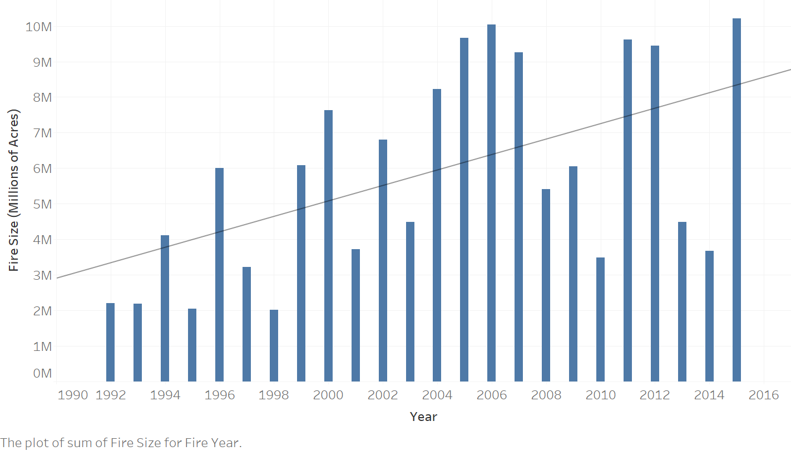
Wildfire frequency has not increased over time, but the size of fires has
Notes:
Frequency actually not. Acres burned has. Cycles up/down 2004-2007, calm period, increase again. Over time clear upward trend. Next wanted to understand where.

Slide 7
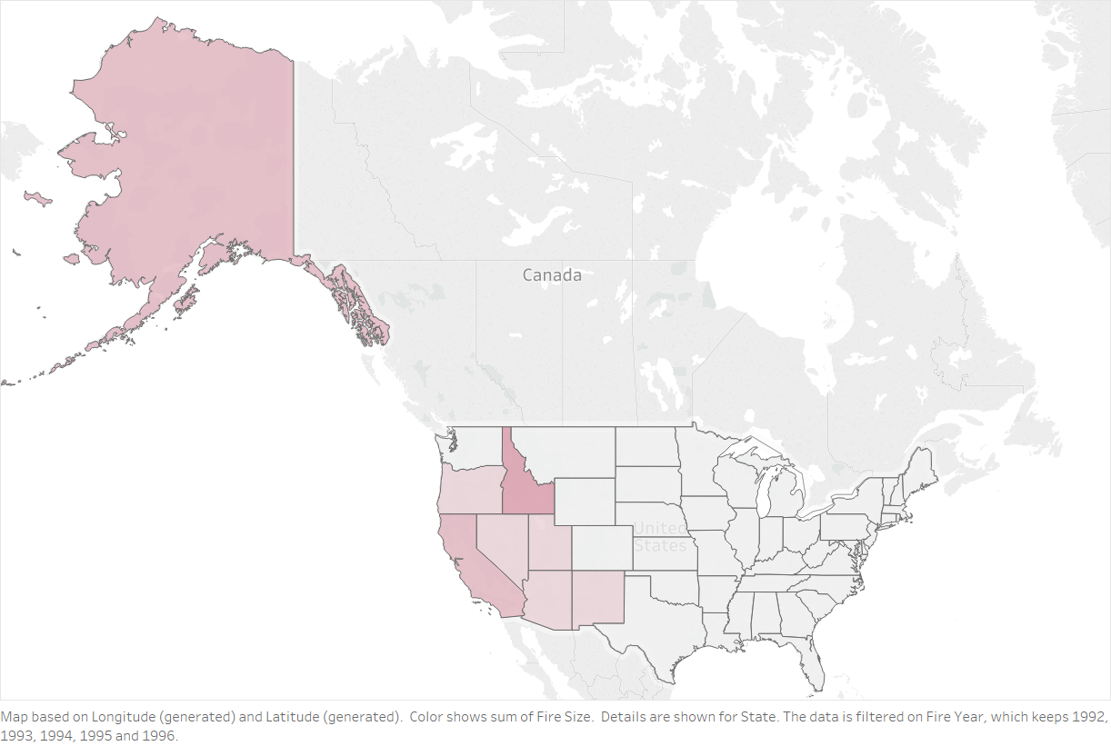
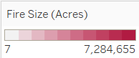
The West Coast has been the biggest contributors to wildfires in the U.S.
1992
-
1996
Notes:
Period 1992-1996
Total acres over that time period
West coast: AK, CA, ID

Slide 8
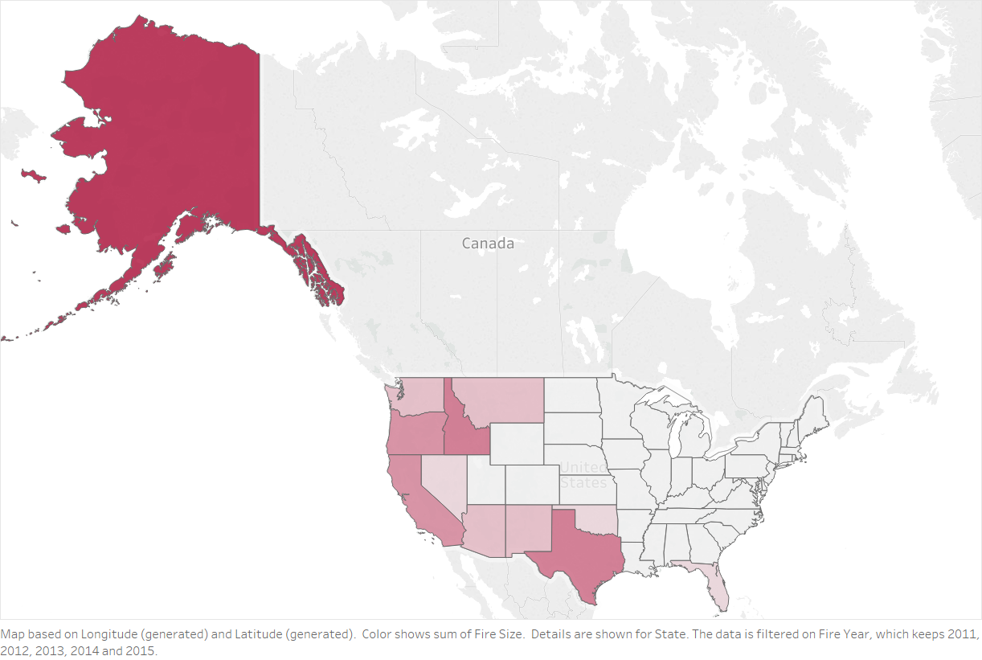
The West Coast has been the biggest contributors to wildfires in the U.S.
2012
-
2015
Notes:
AK saw big increase, new states in play: TX, WA, OR, FL.
Idaho has most amount of land burned per year (1.5%). Mostly federal land.
What is unique about Florida as the only east coast state? Mostly lightning, but other issue

Slide 9
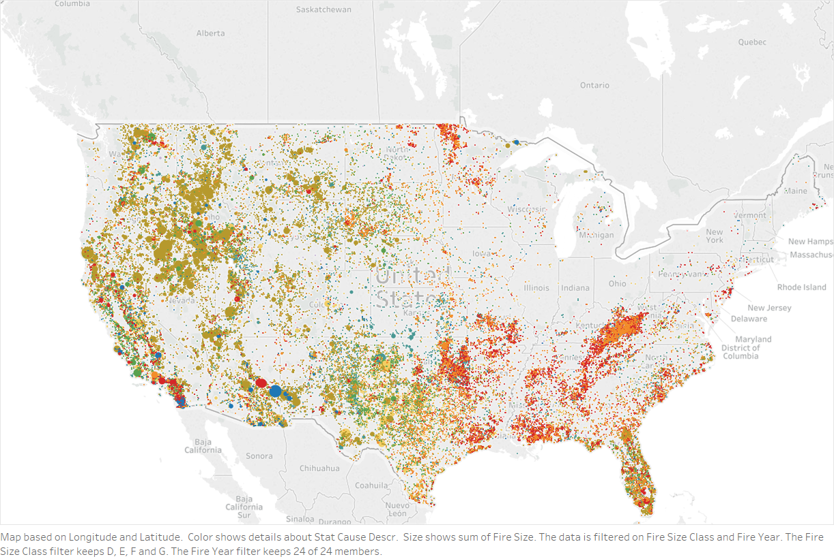
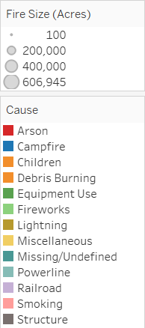
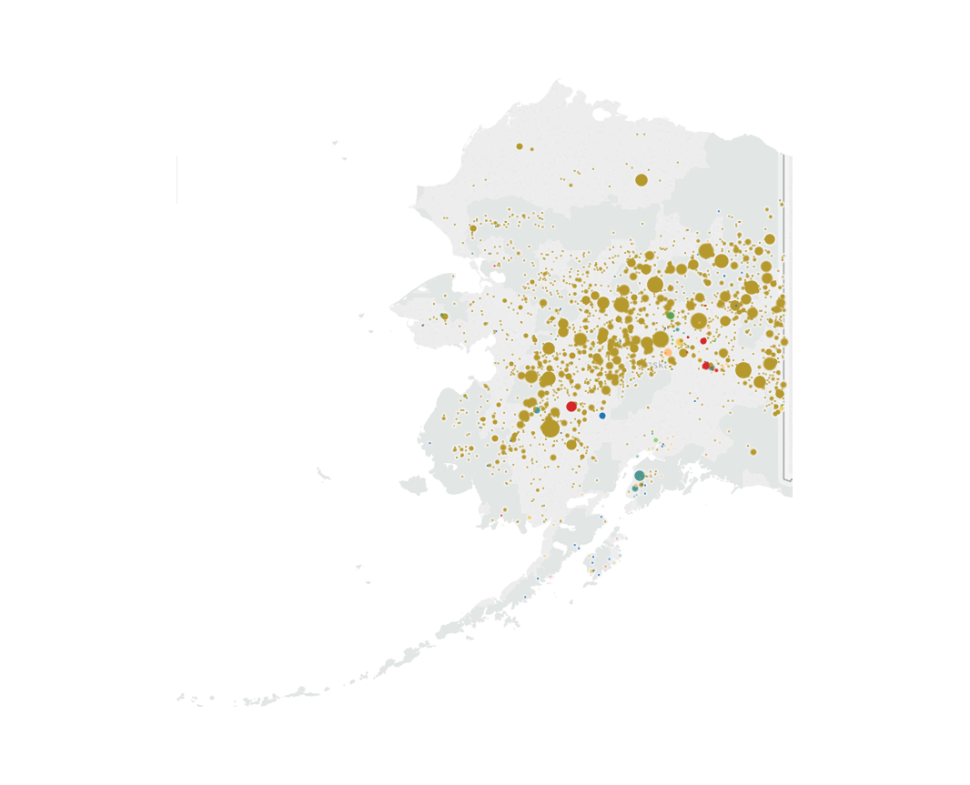
Lightning is the leading cause of wildfires
Notes:
In west, lightning a big driver.
Preventable causes not a big driver in the west, but moreso in the East. Kentucky/WV-> arson, debris burning. CA equipment use, powerlines. TX-> equipment use. FL->Equipment and railroads. Want to drill in on top cause: lightning

Slide 10
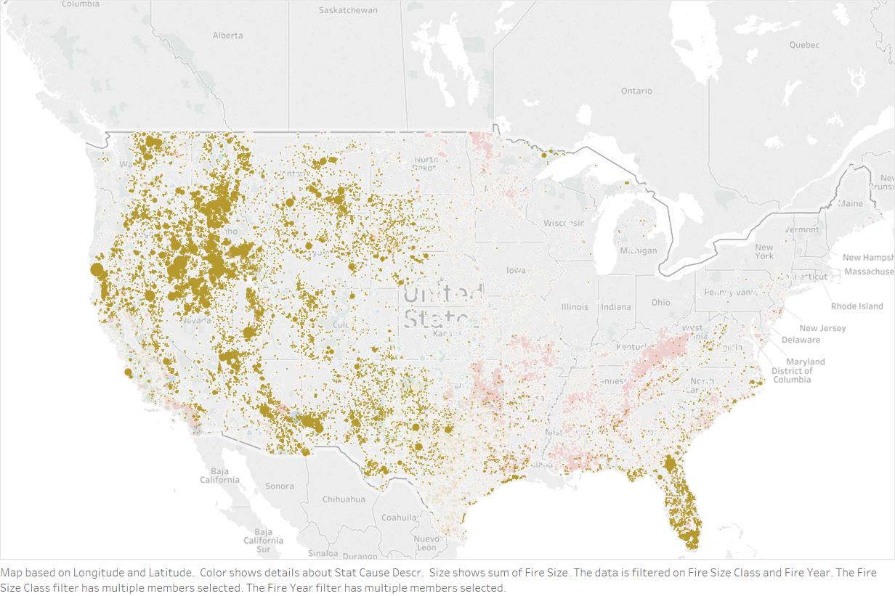
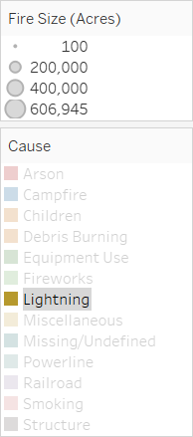
Lightning is the leading cause of wildfires
Notes:
Lighting strikes are the biggest driver wildfires by acreage in every year and are the key drivers in 2004-2007, 2012 and 2015. The number of acres burned due to lightning tripled during the 4 years 2004-2007 vs. the prior four years. Lightning accounted for 71% of wildfire land burned during those four years (long term average 59%).

Slide 11
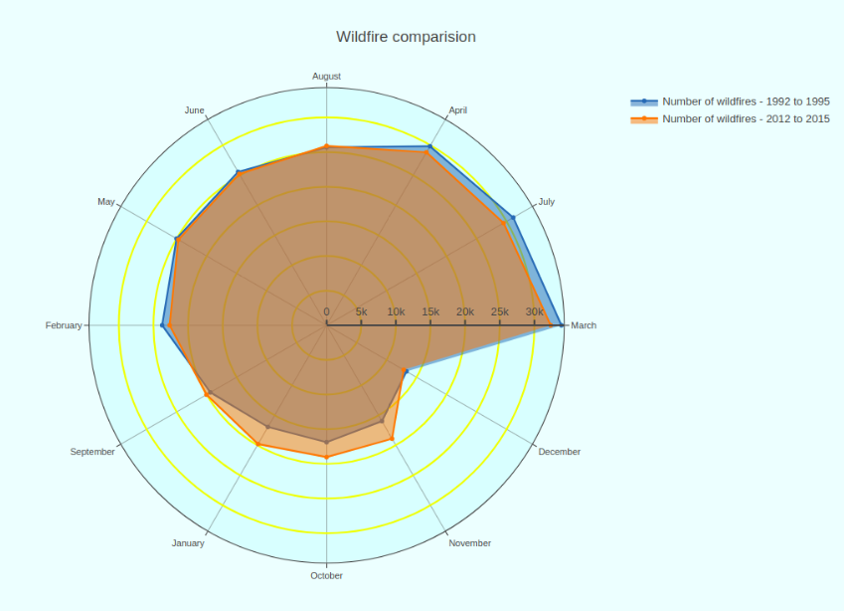
Wildfires occur most frequently in the spring and late summer

Slide 12
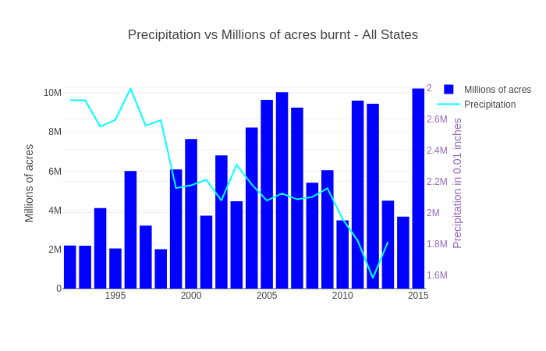
Is rainfall affecting the size of wildfires ?

Slide 13
Conclusions and takeaways
Fire frequency has not changed, but the severity has increased.
The greatest cause of wildfires is not preventable, but severity can be reduced through improved monitoring and planning.
Some states have made greater strides than others in reducing preventable fires, implying the opportunity for targeted policy changes.
The spring and late summer remain the riskiest months for wildfires, although there has been a slight increase in wildfires in other months of the year. Wildfire monitoring should be increased during these months.
Climate change is likely a contributing factor to the increased severity of wildfires in recent years, as evidenced by declining rainfall totals. More effort needs to be exerted at a national level to rectify this trend.
Notes:
Where targeted improvements? Texas (equipment), California (equipment, powerlines), Alabama (brush, arson), Arizona (campfires)
Good strides: NC, SC, GA.

Slide 14
Citations
Images
Fuller, Thomas. “Three Weeks After Fire, Official Search for Dead Is Completed.” The New York Times, The New York Times, 29 Nov. 2018, www.nytimes.com/2018/11/29/us/victims-california-fires-missing.html.
www.proshiksha.com. (2019). [online] Available at: https://proxy.duckduckgo.com/iu/?u=http%3A%2F%2Fwww.proshiksha.com%2Fwp-content%2Fuploads%2F2017%2F04%2FGrowth-icon-300x300.png&f=1 [Accessed 6 Mar. 2019].
Nasa.gov. (2019). [online] Available at: https://www.nasa.gov/images/content/193857main_wildfire_oct22_full.jpg [Accessed 6 Mar. 2019].
Data
Kaggle.com. (2019). 1.88 Million US Wildfires. [online] Available at: https://www.kaggle.com/rtatman/188-million-us-wildfires [Accessed 6 Mar. 2019]
(NCEI), N. (2019). U.S. Hourly Precipitation Data. [online] Data.nodc.noaa.gov. Available at: https://data.nodc.noaa.gov/cgi-bin/iso?id=gov.noaa.ncdc:C00313 [Accessed 6 Mar. 2019].
NSTATE, w. (2019). 50 States in Square Miles from NETSTATE.COM. [online] Netstate.com. Available at: http://www.netstate.com/states/tables/st_size.htm [Accessed 6 Mar. 2019].

